Slide 1




Slide 2
Fine-tune Bert for sentiment analysis

Slide 3
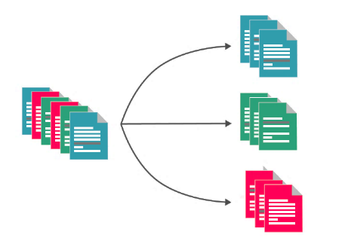
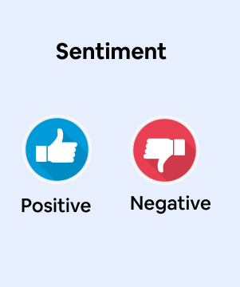
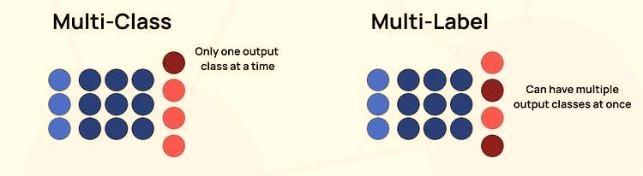
Introduction
Text Classification: text categorization, involves assigning a document (such as a sentence, Twitter post, book chapter, or email content) to a predefined category from a list of classes.
Classification Types:

Slide 4



Introduction
Score Range
[-1,1]
Or
[1-5]
Regression Model

Slide 5
Fine-tune BERT for Sentiment Analysis
Load DistilBert model:
Load IMDB dataset:
Check the shape of the dataset:
from torch import cuda
device = 'cuda' if cuda.is_available() else 'cpu’
from transformers import DistilBertTokenizerFast, DistilBertForSequenceClassification
model_path= 'distilbert-base-uncased'
tokenizer = DistilBertTokenizerFast.from_pretrained(model_path)
model = DistilBertForSequenceClassification.from_pretrained(model_path, id2label={0:"NEG", 1:"POS"}, label2id={"NEG":0, "POS":1})
from datasets import load_dataset
imdb_train= load_dataset('imdb', split="train")
imdb_test= load_dataset('imdb', split="test[:6250]+test[-6250:]")
imdb_val= load_dataset('imdb', split="test[6250:12500]+test[-12500:-6250]")
imdb_train.shape, imdb_test.shape, imdb_val.shape
((25000, 2), (12500, 2), (12500, 2))

Slide 6
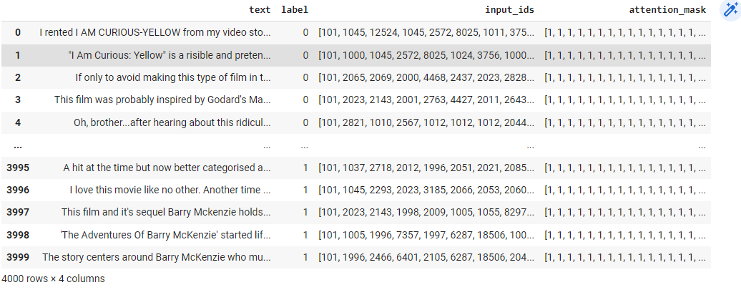
Fine-tune BERT for Sentiment Analysis
For low computational resources:
Prepare data for training:
Preview training data:
imdb_train= load_dataset('imdb', split="train[:2000]+train[-2000:]")
imdb_test= load_dataset('imdb',split="test[:500]+test[-500:]")
imdb_val= load_dataset('imdb', split="test[500:1000]+test[-1000:-500]")
train = imdb_train.map(lambda e: tokenizer(e['text'], padding=True, truncation=True), batched=True,batch_size=1000)
test = imdb_test.map(lambda e: tokenizer( e['text'],padding=True, truncation=True), batched=True, batch_size=1000)
val = imdb_val.map(lambda e: tokenizer( e['text'],padding=True, truncation=True), batched=True, batch_size=1000)
import pandas as pd
pd.DataFrame(train)

Slide 7
Fine-tune BERT for Sentiment Analysis
Define training argument
from transformers import TrainingArguments, Trainer
training_args = TrainingArguments(
output_dir='./MyIMDBModel’,
do_train=True,
do_eval=True,
num_train_epochs=3,
per_device_train_batch_size=32,
per_device_eval_batch_size=64,
warmup_steps=100,
weight_decay=0.01,
logging_strategy='steps’,
logging_dir='./logs',
logging_steps=200,
evaluation_strategy= 'steps’,
fp16= cuda.is_available(),
load_best_model_at_end=True)

Slide 8
Fine-tune BERT for Sentiment Analysis
Evaluation metric → monitor the progress of the training in terms of metrics such as Precision, RMSE, or Pearson correlation .
from sklearn.metrics import accuracy_score, precision_recall_fscore_support
def compute_metrics(pred):
labels = pred.label_ids
preds = pred.predictions.argmax(-1)
Precision, Recall, f1, _ = precision_recall_fscore_support(labels, preds, average='macro')
acc = accuracy_score(labels, preds)
return {
'Accuracy': acc,
'F1': f1,
'Precision': Precision,
'Recall': Recall
}

Slide 9
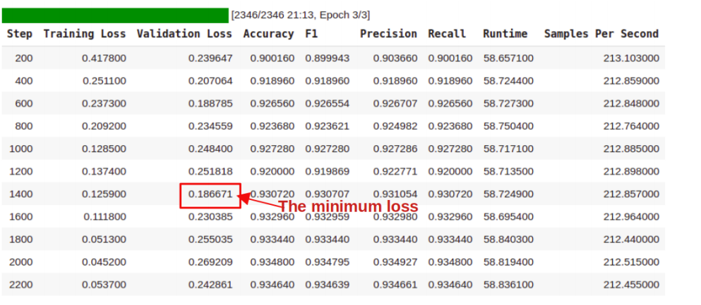
Fine-tune BERT for Sentiment Analysis
Strat Training
trainer = Trainer(
model=model,
args=training_args,
train_dataset=train,
eval_dataset=eval,
compute_metrics= compute_metrics
)
results=trainer.train()

Slide 10
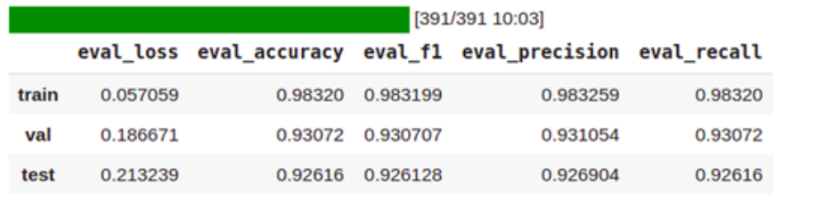
Fine-tune BERT for Sentiment Analysis
Evaluate checkpoint
Define a prediction function to simplify the prediction steps
q = [ trainer.evaluate(eval_dataset=data) for data in[enc_train, enc_val, enc_test ] ]
pd.DataFrame( q , index=["train","val","test"]).iloc[:,:5]
def get_prediction(text):
inputs = tokenizer(text, padding=True,truncation=True, max_length=250, return_tensors="pt").to(device)
outputs = model(inputs["input_ids"].to(device),inputs["attention_mask"].to(device))
probs = outputs[0].softmax(1)
return probs, probs.argmax()
text = "I didn't like the movie it bored me "
get_prediction(text)[1].item()
ans : 0

Slide 11
Fine-tune BERT for Sentiment Analysis
Save the best model for further inference:
Use Pipeline Module:
model_save_path = "MyBestIMDBModel"
trainer.save_model(model_save_path)
tokenizer.save_pretrained(model_save_path)
from transformers import pipeline , DistilBertForSequenceClassification, DistilBertTokenizerFast
model= DistilBertForSequenceClassification.from_pretrained("MyBestIMDBModel")
tokenizer= DistilBertTokenizerFast.from_pretrained("MyBestIMDBModel")
SA_model= pipeline("sentiment-analysis", model=model, tokenizer=tokenizer)
SA_model("the movie was very impressive")
[{'label': 'POS', 'score': 0.9886765480041504}]

